Slide 1
Representation of binary trees in Memory

Slide 2
Sequential/Array representation
 | TREE
1 | 45
2 | 22
3 | 77
4 | 11
5 | 30
6
7 | 90
8
9 | 15
10 | 25
11
12
13
14 | 88
15
16
.
.
.
29
The root R of T is stored in TREE[1]
If a node N occupies TREE[K],
left child is stored in TREE[2*K]
right child is stored in TREE[2*K+1]
45
22
77
11
30
90
15
25
88

Slide 3
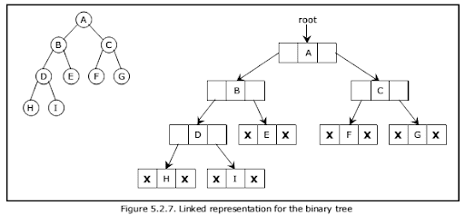
Linked Representation
INFO[K] contains the data of the node N.
LEFT[K] contains the location of the left child of node N.
RIGHT[K] contains the location of the right child of node N.
ROOT will contain the location of the root R of T.

Slide 4
Traversing Binary Trees
Preorder | Inorder | Postorder
1) Process the root R. | 1) Traverse the left subtree of R in inorder. | 1) Traverse the left subtree of R in postorder.
2) Traverse the left subtree of R in preorder. | 2) Process the root R. | 2) Traverse the right subtree of R in postorder.
3) Traverse the right subtree of R in preorder. | 3) Traverse the right subtree of R in inorder. | 3) Process the root R.

Slide 5
Example
A
B
C
Pre order: A, B, D, F, E, J, K, C, G, H, I, N, M
In order: F, D, B, J, E, K, A, G, C, N, I, H, M
Post order: F, D, J, K, E, B, G, N, I, M, H, C, A
D
E
G
H
F
J
K
I
M
N

Slide 6
Equation: {(A+B)/3}-(D+E)
-
/
+
Pre order: -, /, +, A, B, 3, +, D, E
In order: A, +, B, /, 3, -, D, +, E
Post order: A, B, +, 3, /, D, E, +, -
+
3
D
E
A
B

Slide 7
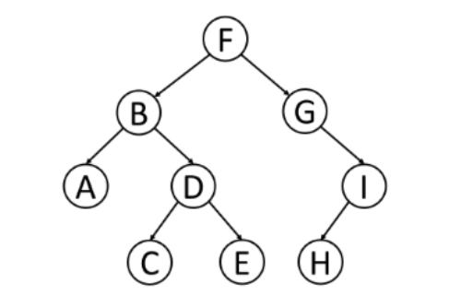
Practice problem

Slide 8
Ternary tree representation
1
Left Child: 3K-1
Middle: 3K
Right Child: 3K+1
2
3
4
5
6
7
8
9
10
11
12
13

